Slide 1
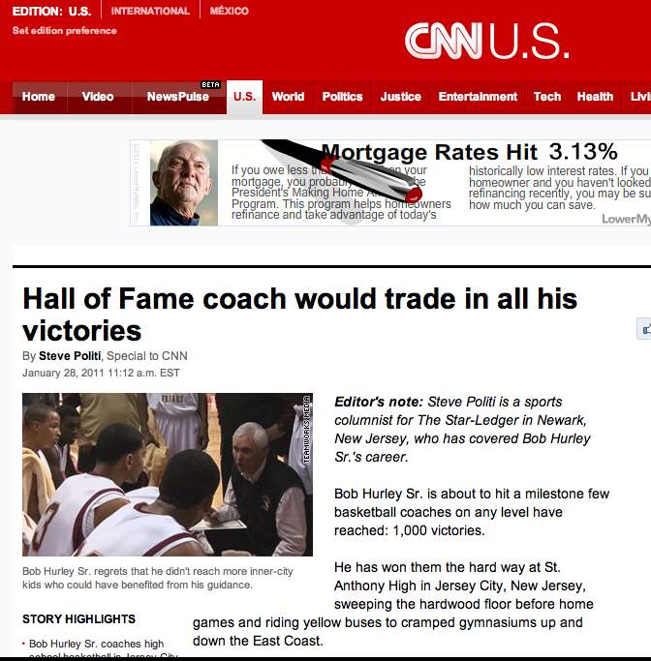
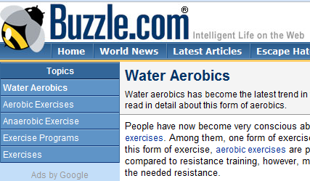
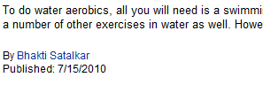
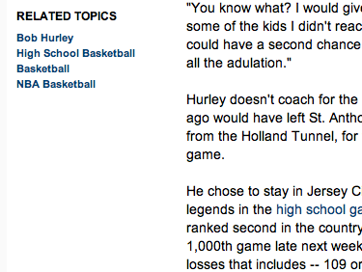
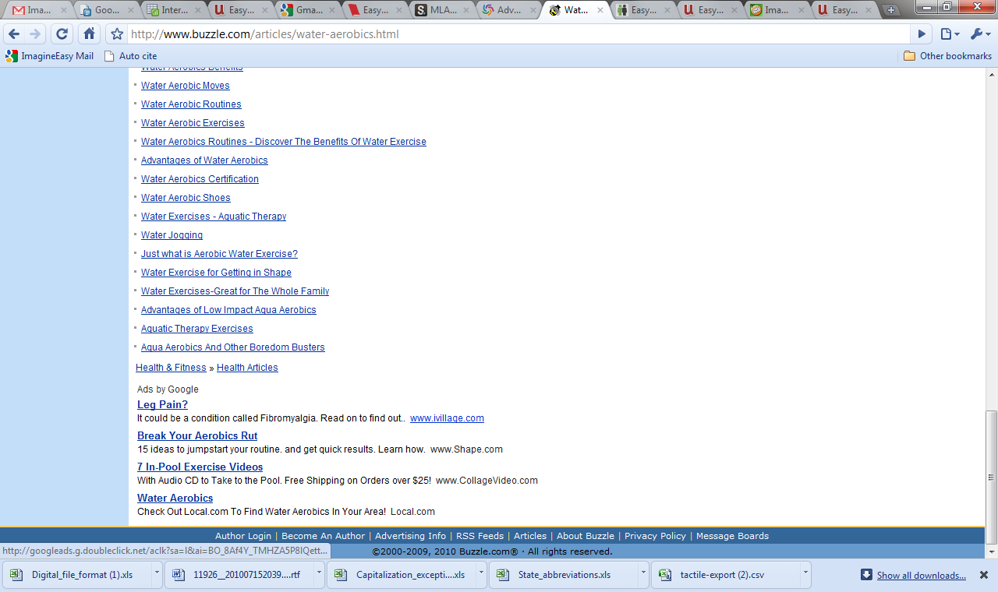
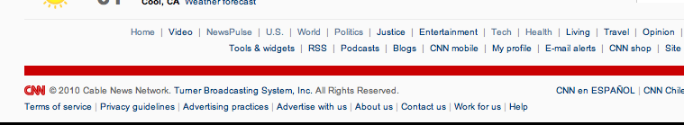
Website Evaluation Guide
Citing a website article - MLA
Cite it at easybib.com
Example of a Website that is credible
Website: A collection of online informational pages on the world wide web that typically covers related topics
Top of the article
Structure: Last, First M. “Website article.” Website. Publisher, Date published. Web. Date accessed. <URL>.
Author: This author is a journalist and has verifiable credentials
*Note: URL is optional. Consult your teacher
Website
Website article
Currency: This article provides a publishing date and it is current
Bottom of article
Within the article
Author
Citations & Links: News articles don’t usually have or require citations, but a good source provides links for further reading on the subject
Date electronically published: 7/15/10
Article footer – Often contains website publisher information
Website publisher
Data accessed: Depends on the day
When did you access the source? Web sources may change and must be considered unique
Article Footer
Publisher: This site provides a publisher, who upon investigation, was found to take responsibility for their content and to be credible
Citation: Satalkar, Bhakti. “Water Aerobics." Buzzle.com. Buzzle.com, 15 July 2010. Web. 16 July 2010.
AUTOMATICALLY CITE YOUR SOURCES FOR FREE AT WWW.EASYBIB.COM

Slide 2
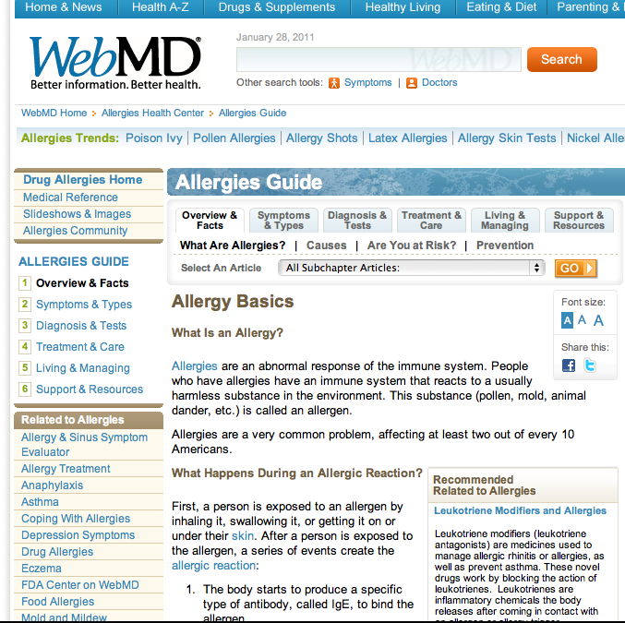
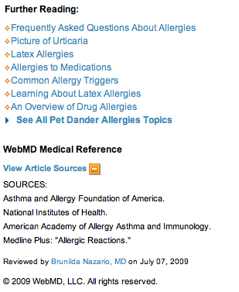
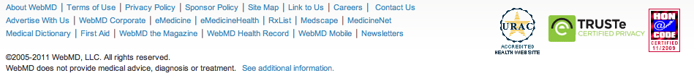
Website Evaluation Guide
Citing a website article - MLA
Cite it at easybib.com
Example of a Website that is credible
Website: A collection of online informational pages on the world wide web that typically covers related topics
Top of the article
Structure: Last, First M. “Website article.” Website. Publisher, Date published. Web. Date accessed. <URL>.
*Note: URL is optional. Consult your teacher
Citations & Links: A good source provides citations for its information as well as links for further reading on the subject
Website
Website article
Within the article
Bottom of article
Author
Date electronically published: 7/15/10
Author: This author is a journalist and has verifiable credentials
Article footer – Often contains website publisher information
Website publisher
Currency: This article provides a publishing date and it is current
Publisher: This site provides a publisher, who upon investigation, was found to take responsibility for their content and to be credible
Data accessed: Depends on the day
When did you access the source? Web sources may change and must be considered unique
Article Footer
Citation: Satalkar, Bhakti. “Water Aerobics." Buzzle.com. Buzzle.com, 15 July 2010. Web. 16 July 2010.
AUTOMATICALLY CITE YOUR SOURCES FOR FREE AT WWW.EASYBIB.COM

Slide 3
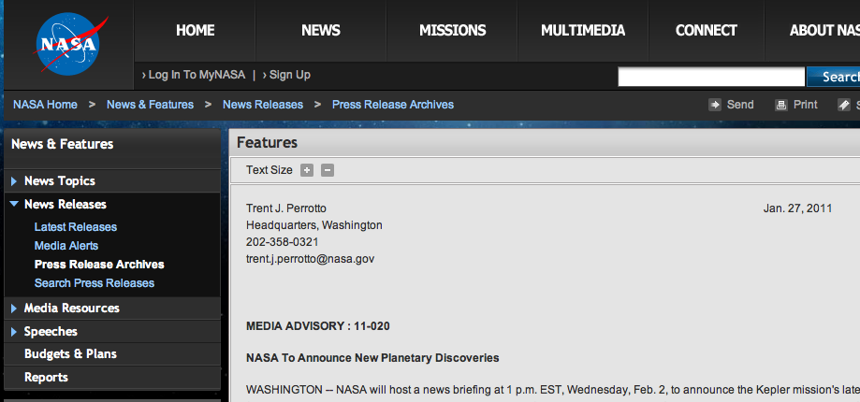
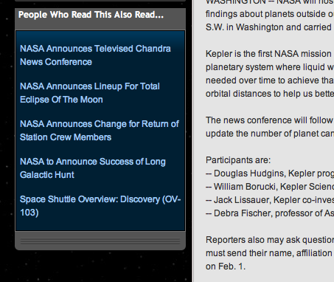

Website Evaluation Guide
Citing a website article - MLA
Cite it at easybib.com
Example of a Website that is credible
Website: A collection of online informational pages on the world wide web that typically covers related topics
Top of the article
Structure: Last, First M. “Website article.” Website. Publisher, Date published. Web. Date accessed. <URL>.
*Note: URL is optional. Consult your teacher
Website
Website article
Author: This author is a journalist and has verifiable credentials
Currency: This article provides a publishing date and it is current
Within the article
Bottom of article
Author
Citations & Links: News articles don’t usually have or require citations, but a good source provides links for further reading on the subject
Date electronically published: 7/15/10
Article footer – Often contains website publisher information
Website publisher
Publisher: This site provides a publisher, who upon investigation, was found to take responsibility for their content and to be credible
Data accessed: Depends on the day
When did you access the source? Web sources may change and must be considered unique
Article Footer
Citation: Satalkar, Bhakti. “Water Aerobics." Buzzle.com. Buzzle.com, 15 July 2010. Web. 16 July 2010.
AUTOMATICALLY CITE YOUR SOURCES FOR FREE AT WWW.EASYBIB.COM

Slide 4
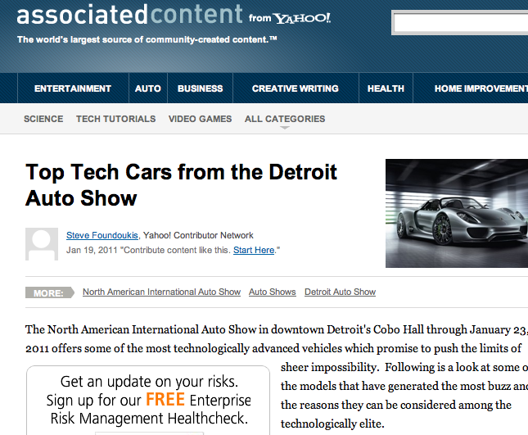
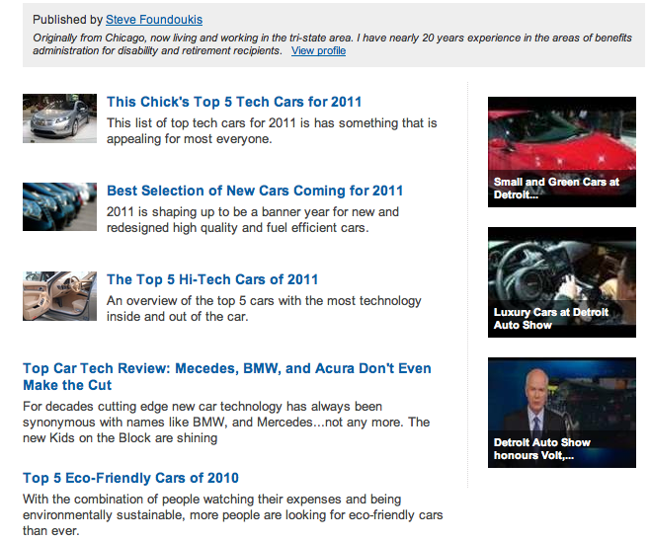
Website Evaluation Guide
Citing a website article - MLA
Cite it at easybib.com
Example of a Website that may be credible
Website: A collection of online informational pages on the world wide web that typically covers related topics
Top of the article
Structure: Last, First M. “Website article.” Website. Publisher, Date published. Web. Date accessed. <URL>.
*Note: URL is optional. Consult your teacher
Currency: This article provides a publishing date and it is current
Website
Website article
Author: The authors for this site vary greatly in their journalistic experience and credentials, therefore it is difficult to know if this content should be trusted.
Within the article
Bottom of article
Author
Citations & Links: News articles don’t usually have or require citations, but should at least provide links for further reading on the subject
Date electronically published: 7/15/10
Article footer – Often contains website publisher information
Website publisher
Data accessed: Depends on the day
When did you access the source? Web sources may change and must be considered unique
Publisher: This site provides a publisher, who upon investigation, was found to be credible, but doesn’t necessarily take responsibility for the content
Citation: Satalkar, Bhakti. “Water Aerobics." Buzzle.com. Buzzle.com, 15 July 2010. Web. 16 July 2010.
Article Footer
AUTOMATICALLY CITE YOUR SOURCES FOR FREE AT WWW.EASYBIB.COM

Slide 5
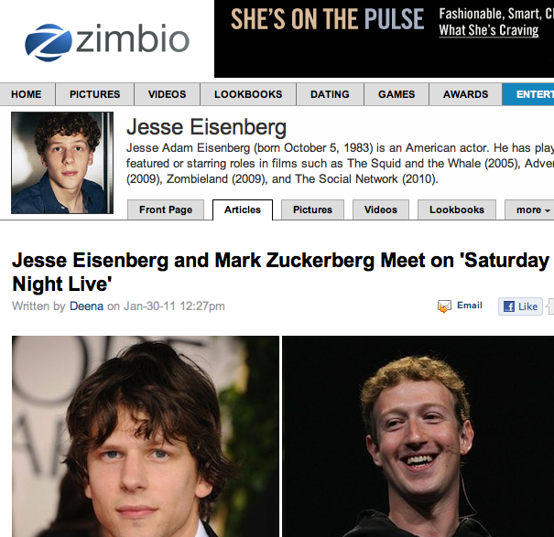
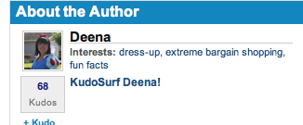
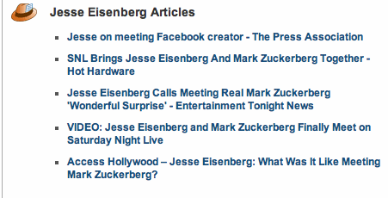

Website Evaluation Guide
Citing a website article - MLA
Cite it at easybib.com
Example of a Website that may be credible
Website: A collection of online informational pages on the world wide web that typically covers related topics
Top of the article
Structure: Last, First M. “Website article.” Website. Publisher, Date published. Web. Date accessed. <URL>.
*Note: URL is optional. Consult your teacher
Website
Author: The authors on this site range in journalistic experience and credentials, and therefore it is difficult to decide if the information they present should be trusted.
Website article
Currency: This article provides a publishing date and it is current
Bottom of article
Author
Within the article
Citations & Links: News articles don’t usually have or require citations, but should at least provide links for further reading on the subject
Date electronically published: 7/15/10
Article footer – Often contains website publisher information
Website publisher
Publisher: This site provides a publisher, who upon investigation, was found to be credible but doesn’t necessarily take responsibility for the content they publish.
Data accessed: Depends on the day
When did you access the source? Web sources may change and must be considered unique
Article Footer
Citation: Satalkar, Bhakti. “Water Aerobics." Buzzle.com. Buzzle.com, 15 July 2010. Web. 16 July 2010.
AUTOMATICALLY CITE YOUR SOURCES FOR FREE AT WWW.EASYBIB.COM

Slide 6
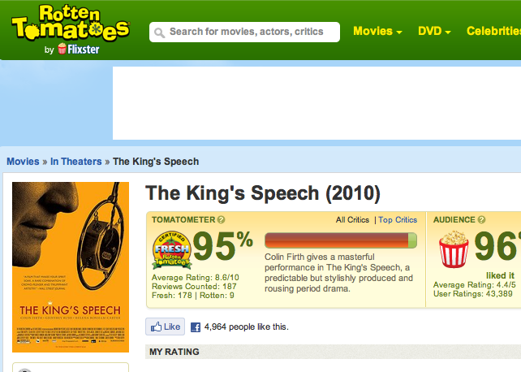
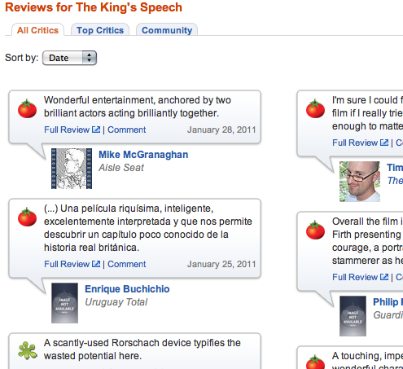
Website Evaluation Guide
Citing a website article - MLA
Cite it at easybib.com
Example of a Website that may be credible
Website: A collection of online informational pages on the world wide web that typically covers related topics
Top of the article
Structure: Last, First M. “Website article.” Website. Publisher, Date published. Web. Date accessed. <URL>.
*Note: URL is optional. Consult your teacher
Author: The authors of the reviews for this site vary greatly in their journalistic experience and credentials, therefore it is difficult to decide whether the information provided should be trusted.
Website
Website article
Within the article
Currency: Each individual review provides a publishing date.
Bottom of article
Author
Citations & Links: News articles don’t usually have or require citations, but should at least give links to related topics. This website links to other reviews.
Date electronically published: 7/15/10
Article footer – Often contains website publisher information
Website publisher
Publisher: This site provides a publisher, who upon investigation, was found to be credible, but doesn’t necessarily take responsibility for the content they provide.
Data accessed: Depends on the day
When did you access the source? Web sources may change and must be considered unique
Citation: Satalkar, Bhakti. “Water Aerobics." Buzzle.com. Buzzle.com, 15 July 2010. Web. 16 July 2010.
Article Footer
AUTOMATICALLY CITE YOUR SOURCES FOR FREE AT WWW.EASYBIB.COM

Slide 7
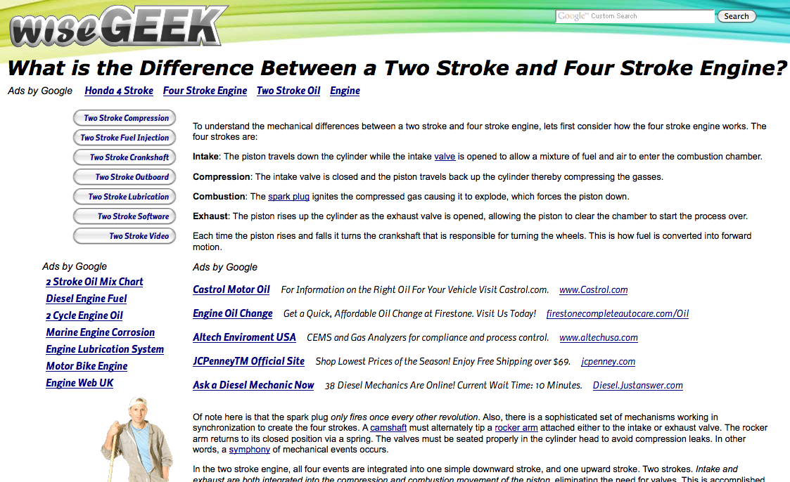
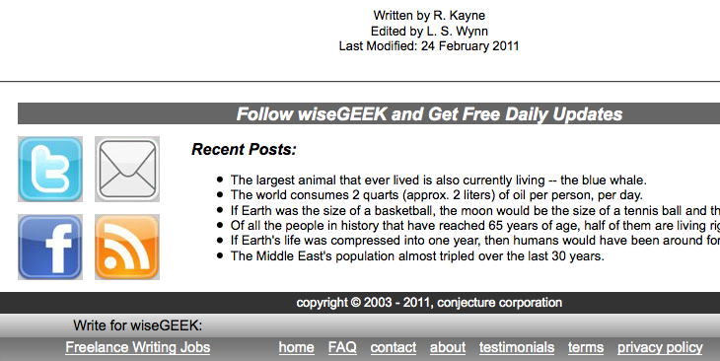
Website Evaluation Guide
Citing a website article - MLA
Cite it at easybib.com
Example of a Website that is not credible
Website: A collection of online informational pages on the world wide web that typically covers related topics
Top of the article/Within the article
Structure: Last, First M. “Website article.” Website. Publisher, Date published. Web. Date accessed. <URL>.
Citations & Links: The articles on this site do not cite their information. Following the related article links leads to questionable sources. This is a site that publishes massive amounts of information to direct the most amount of web searches to their page to drive up their ad revenue. They are not concerned with publishing articles to provide good and reliable information.
*Note: URL is optional. Consult your teacher
Website
Website article
Bottom of article
Author: The authors on this site are only identified by a first name initial and last name. Therefore it is impossible to search for them and discern their credibility/expertise/level of knowledge on their topic.
Author
Currency: This article provides a publishing date and it is current, but not all articles on this site are up to date.
Date electronically published: 7/15/10
Article footer – Often contains website publisher information
Article Footer
Website publisher
Publisher: This site provides a publisher, who upon investigation, was found to be of questionable credibility and does not take responsibility for the content that is published.
Data accessed: Depends on the day
When did you access the source? Web sources may change and must be considered unique
Citation: Satalkar, Bhakti. “Water Aerobics." Buzzle.com. Buzzle.com, 15 July 2010. Web. 16 July 2010.
AUTOMATICALLY CITE YOUR SOURCES FOR FREE AT WWW.EASYBIB.COM

Slide 8
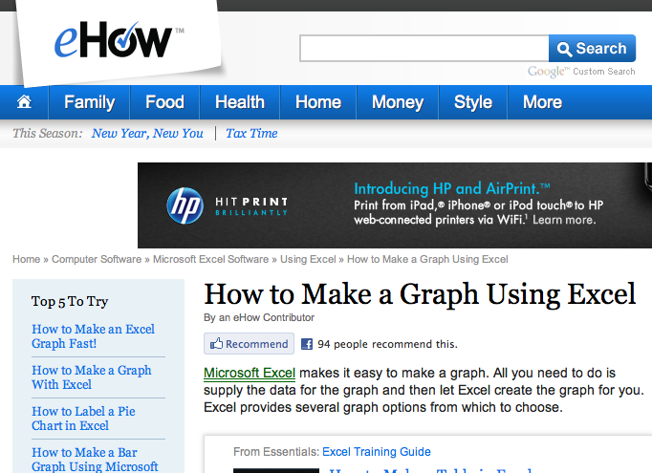
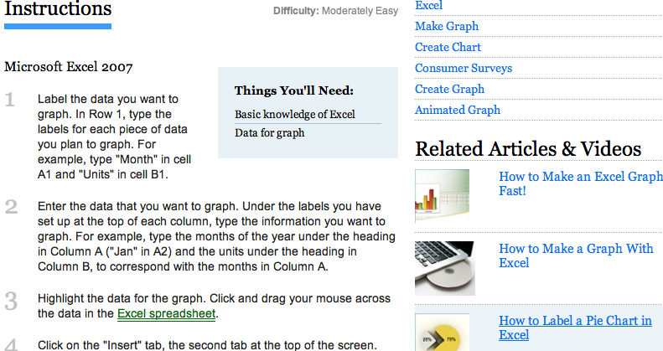

Website Evaluation Guide
Citing a website article - MLA
Cite it at easybib.com
Example of a Website that is not credible
Website: A collection of online informational pages on the world wide web that typically covers related topics
Top of the article
Structure: Last, First M. “Website article.” Website. Publisher, Date published. Web. Date accessed. <URL>.
Author: The authors on this site are not given, and therefore it is impossible to discern their credentials and authority to speak on any given subject.
*Note: URL is optional. Consult your teacher
Website
Currency: This article does not provide a publication date, therefore it is impossible to tell whether the information it provides is out of date.
Website article
Within the article
Citations & Links: The articles on this site do not cite their information. Following the related article links leads to questionable content, and reveals one of the main criticisms of eHow.com. This is a site that publishes massive amounts of articles based on what will direct the most amount of web searches to their page in order to drive up their ad revenue. They are not concerned with publishing articles because they want to provide good and reliable information.
Bottom of article
Author
Date electronically published: 7/15/10
Article footer – Often contains website publisher information
Website publisher
Publisher: This site provides a publisher, who upon investigation, was found to have questionable credibility and who does not take responsibility for the content they provide.
Data accessed: Depends on the day
When did you access the source? Web sources may change and must be considered unique
Article Footer
Citation: Satalkar, Bhakti. “Water Aerobics." Buzzle.com. Buzzle.com, 15 July 2010. Web. 16 July 2010.
AUTOMATICALLY CITE YOUR SOURCES FOR FREE AT WWW.EASYBIB.COM

Slide 9
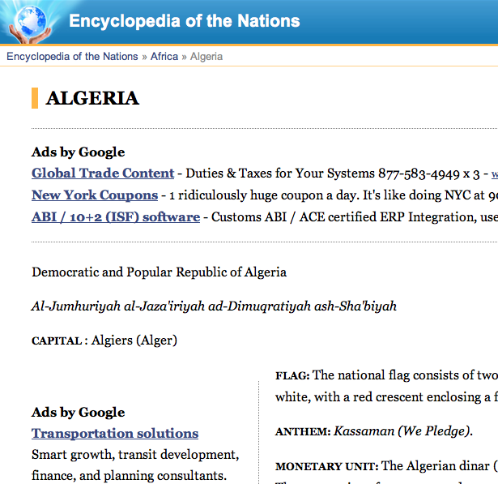
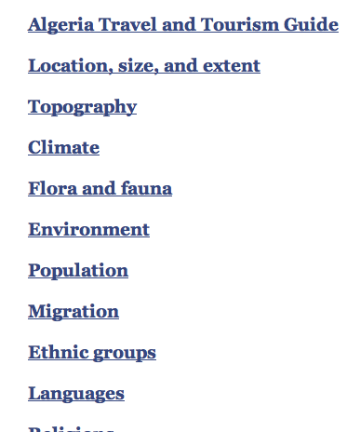

Website Evaluation Guide
Citing a website article - MLA
Cite it at easybib.com
Example of a Website that is not credible
Website: A collection of online informational pages on the world wide web that typically covers related topics
Top of the article
Structure: Last, First M. “Website article.” Website. Publisher, Date published. Web. Date accessed. <URL>.
*Note: URL is optional. Consult your teacher
Author: The authors on this site are not given, and therefore it is impossible to discern their credentials and authority to speak on any given subject.
Website
Website article
Currency: This article does not provide a publication date, therefore it is impossible to tell if the information it provides is out of date.
Within the article
Bottom of article
Author
Citations & Links: The articles on this site do not cite their information. Following the related article links leads to questionable content.
Date electronically published: 7/15/10
Article footer – Often contains website publisher information
Website publisher
Data accessed: Depends on the day
When did you access the source? Web sources may change and must be considered unique
Publisher: This site provides a publisher, who upon investigation, was found to have questionable credibility and who does not take responsibility for the content they provide.
Citation: Satalkar, Bhakti. “Water Aerobics." Buzzle.com. Buzzle.com, 15 July 2010. Web. 16 July 2010.
Article Footer
AUTOMATICALLY CITE YOUR SOURCES FOR FREE AT WWW.EASYBIB.COM

Slide 10
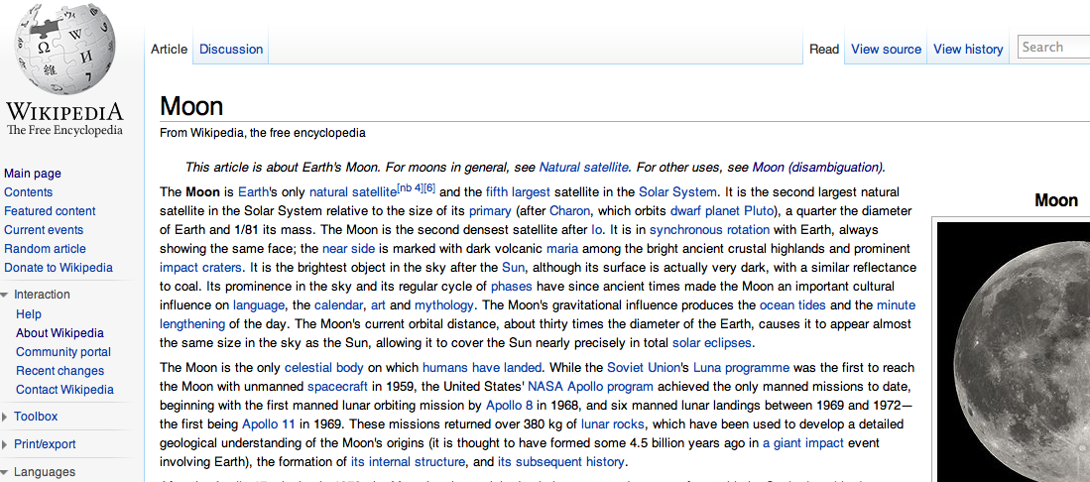
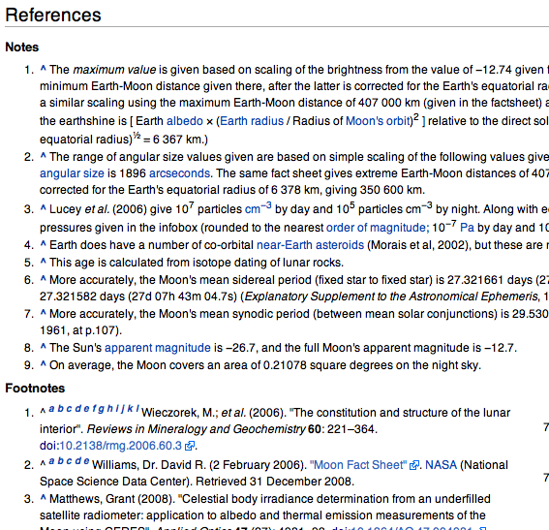
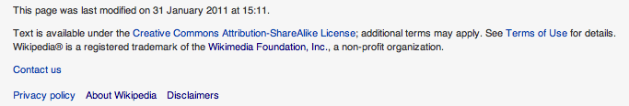
Website Evaluation Guide
Citing a website article - MLA
Cite it at easybib.com
A Special Note on Wikipedia
Website: A collection of online informational pages on the world wide web that typically covers related topics
Wikipedia is a good source of general reference information that can have data that is on par with other encyclopedias. However, when one is writing a research paper it is never favorable to cite general reference sources. Primary and topic-specific resources are always the best sources of information. Wikipedia, and other encyclopedias, are good for users who wish to obtain general information. Wikipedia can also be useful when starting research if you investigate the credible sources they are citing.
Structure: Last, First M. “Website article.” Website. Publisher, Date published. Web. Date accessed. <URL>.
*Note: URL is optional. Consult your teacher
Top of the article
Website
Author: The authors on this site are all users, and therefore it is impossible to discern their credentials and authority to speak on any given subject. This is the main reason why Wikipedia.org should not be cited. While many of the articles on the site have citations and current dates, the fact that the articles are written by users who are not credible and cannot be identified.
Website article
Within the article
Bottom of article
Author
Citations & Links: This source provides citations for the information published as well as links to related content. However,
this is not necessarily true of all
articles on this site. It is better to
use the citations to help you find
credible sources.
Date electronically published: 7/15/10
Article footer – Often contains website publisher information
Website publisher
Data accessed: Depends on the day
When did you access the source? Web sources may change and must be considered unique
Currency: This article provides a publishing date and it is current, but not all articles on this site are up to date.
Publisher: This site provides a publisher, who upon investigation, was found to be credible but does not take responsibility for the content that is published.
Article Footer
Citation: Satalkar, Bhakti. “Water Aerobics." Buzzle.com. Buzzle.com, 15 July 2010. Web. 16 July 2010.
AUTOMATICALLY CITE YOUR SOURCES FOR FREE AT WWW.EASYBIB.COM

Slide 11
Website Evaluation Guide
Citing a website article - MLA
Cite it at easybib.com
Criteria for Evaluating Websites
Website: A collection of online informational pages on the world wide web that typically covers related topics
Main Criteria | Descriptions/Details | Possible Answers
Author | Who is providing the information? What do you know about them and their credentials; are they an expert? Can you find out more and contact them? Search for the author in a search engine. Has the author written several publications on the topic? | Scholars and academics; User generated; journalist; varies greatly; none given; NA
Publisher/ Affiliation | Is the publisher credible? Do they take responsibility for the content? Is there a sponsor or affiliation? What other sources link to that website? | Publisher is credible and takes responsibility; credible but doesn't take responsibility; questionable publisher and does not take responsibility; takes responsibility but is not credible.
Bias/Balance/Purpose | Is the language free of emotion? Does the organization or author indicate there will be bias? Is the purpose of the website to inform or spread an agenda? Are there ads? Are they trying to make money? Why did they write the article? | Sometimes, sometimes - rightist, sometimes – leftist; corporate sponsorship; is balanced; generates content to sell ad space; NA
Citations & Links | Are there links to related sites and are they well organized? Citations/Bibliography provided? | Citations; citations and links; links; no.
Accuracy | Is the data verifiable and accurate? | Yes; unknown; varies; no
Complete | Is the source comprehensive? | Yes; unknown; varies; no
Currency | When was the source last updated? Does the source have a date? | Yes - up to date; yes – varies; not recent; date unknown
Design & Quality | Is the overall web design easy to use? Is it presented in a professional manner? Does it seem like current design? | Good design; unprofessional design; old site; average
Reproduced | Was it reproduced? If so, where? Type a sentence in Google to verify If it was reproduced, was it done so with permission? Was Copyright information or a disclaimer included? | Yes with permission; yes without permission; sometimes with permission; no
Credible | Based on previous criteria, is the source credible? | Yes; maybe; no
Structure: Last, First M. “Website article.” Website. Publisher, Date published. Web. Date accessed. <URL>.
*Note: URL is optional. Consult your teacher
Website
Website article
Bottom of article
Author
Date electronically published: 7/15/10
Article footer – Often contains website publisher information
Website publisher
Data accessed: Depends on the day
When did you access the source? Web sources may change and must be considered unique
Citation: Satalkar, Bhakti. “Water Aerobics." Buzzle.com. Buzzle.com, 15 July 2010. Web. 16 July 2010.
AUTOMATICALLY CITE YOUR SOURCES FOR FREE AT WWW.EASYBIB.COM

